Slide 1
Flying Flashlight
May1738
Adviser: Dr. Gary Tuttle
Brady Koht - Team Leader
Joseph Wickner - Co-Team Leader & Co-Webmaster
Peter Bonnie - Group Communicator
Scott Melvin - Document Master
Sebastian Roe - Webmaster
Team Email – may1738@iastate.edu
http://may1738.sd.ece.iastate.edu

Slide 2
Problem Statement
The Flying Flashlight team strives to design a portable, hands-free, drone based lighting system. Our target demographic will be varied as well as the implementation of our product. We view our product as a multi-purpose utility light.

Slide 3
Requirements and Specifications
Functional
Size
Light Output
Lighting Modes
Tethered
Flight Stability
1 Hour Flight Time
7-10 Foot Flight Ceiling
Non-Functional
Safety Regulations
User Manual
Documentation

Slide 4
Operating Environment
Outdoor Activities
Roadside Emergencies
Night Time/Low-Light Conditions

Slide 5
System Block Diagram

Slide 6
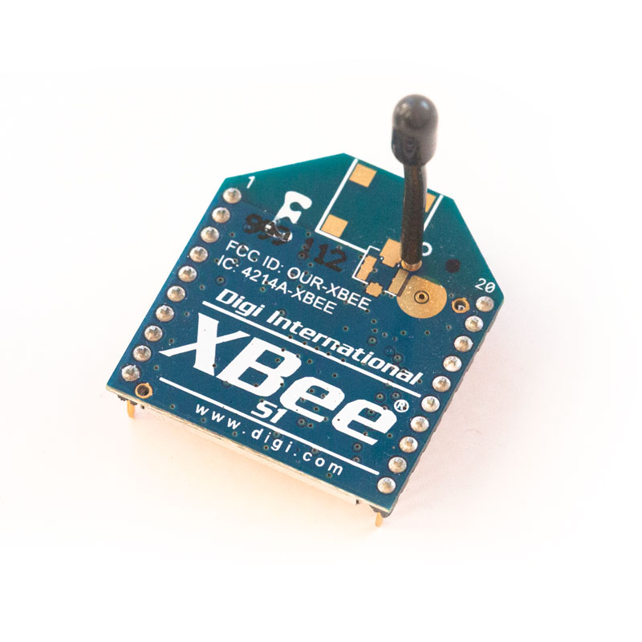
Wireless Communication
XBee series 1 Radio
ISM 2.4 GHz Operating Frequency
Data Rate = 250 kbps
Indoor Range 100ft
Outdoor Range 300ft

Slide 7
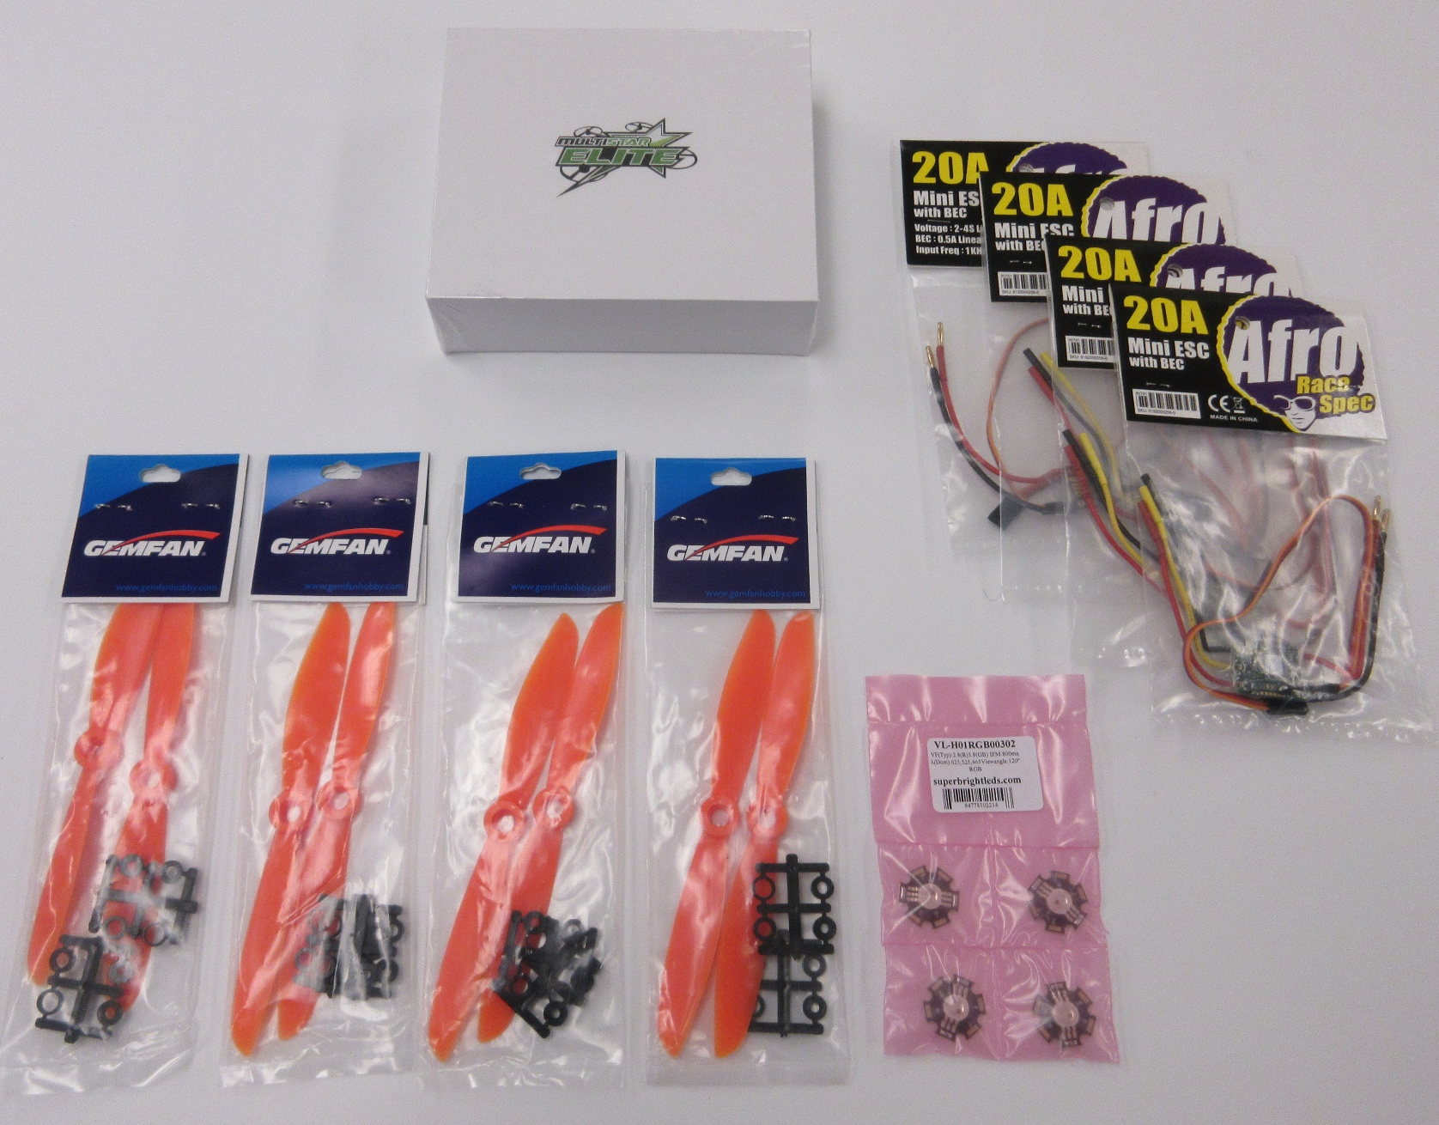
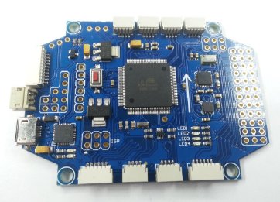
System Analysis and Part Choices
MultiWii Pro vs. DJI Naza
Motors – Multistar Elite Racing 2204
ESC’s – Afro Race Spec
LED’s – Vollong 3W RGB
http://www.readytoflyquads.com/multiwii-pro-ez3-0-flight-controller-w-gps-option

Slide 8
Propeller Choices
5x3
12.6V (3S): 50%=224g 3.7A, 100%= 371g 7.5A (Hover amps @ 125g thrust=1.7A (x 4=500g=6.8A) 8.4V (2S): 50%=120g 2.2A, 100%= 200g 4.3A (Hover amps @ 125g thrust=2.2A (x 4=500g=8.8A)
5x3x3 (3 blade)
12.6V (3S): 50%=232g 4.7A, 100%= 392g 9.9A (Hover amps @ 125g thrust=2.0A (x 4=500g=8A) 8.4V (2S): 50%=134g 2.7A 100%= 221g 6.7A (Hover amps @ 125g thrust=2.7A (x 4=500g=10.8A)
6x4
12.6V (3S): 50%=385g 7.5A, 100%= 591g 9.9A (Hover amps @ 125g thrust=1.4A (x 4=500g=5.6A) 8.4V (2S): 50%=230g 4.8A, 100%= 367g 9.7A (Hover amps @ 125g thrust=2.1A (x 4=500g=8.4A)

Slide 9
Testing Plan

Slide 10
Early Estimated Power Consumption
Assuming Quadcopter Weight at 360g
Flight Controller, MCU, etc. << 1W
LEDs 3W each. 4 LEDs = 12 W
Motor with 5x3 Prop
Hovering Current = 1.7A @ 12.6V each
Total Power = 85W providing 500g Lift
Burst Current = 3.7A @ 12.6V each motor
Total Power = 186W providing 896g Lift
Overestimated 97 W at Hover

Slide 11
Power Consumption
Original frame: 383 g
Double Layer Frame: 383 g
Final Frame: 406 g
Hover Power = 78 W (vs 50.4 W estimate)
LED 100% Power = 23.28 W (vs 12 W estimate)
Total: 101.28 W (vs 97 W estimate)

Slide 12
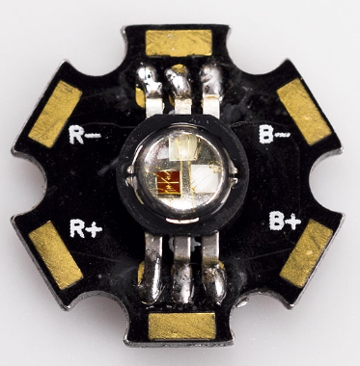
Basic LED PWM Control Schematic
PWM Control From Microcontroller
Vollong 3w RGB Common Cathode LEDS
P-Channel Power MOSFET Choices
Fairchild FQP27P06
Fairchild NDP6020P

Slide 13
LIGHT DATA
 | Red (A) | Green (A) | Blue (A) | All 3 LEDs (A)
100% Brightness | 0.785 | 0.796 | 0.718 | 1.94
50% Brightness | 0.413 | 0.418 | 0.379 | 0.951
Max power consumption from the LED system alone is 23.28 Watts.
Graph data is taken from a distance of 3 feet to 2 inches away.

Slide 14
PCB Design
Atmega328 Microcontroller
XBee Wireless Transceiver
Two voltage regulators: 5v and 3v3
LED driving MOSFETs

Slide 15
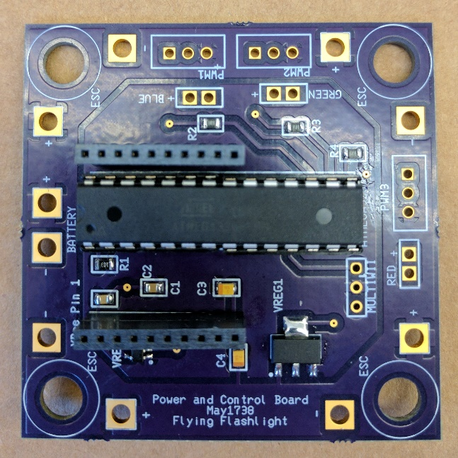
PCB Design
Outer Power Plane: 12v
Inner Power Plane: 5v
Headers for Red, Green, Blue LEDs

Slide 16
Winch Tether System

Slide 17
Winch Tether System
Design work done in SolidWorks
Lee Harker assisted with design
Slip rings used to transfer power
Parts milled using CNC mill, performed by Lee Harker
Aluminum used for end supports
PVC, Acetal used for hubs/drum
Gears supplied by ServoCity
Slip rings supplied by DigiKey
Bearings supplied by McMaster-Carr

Slide 18
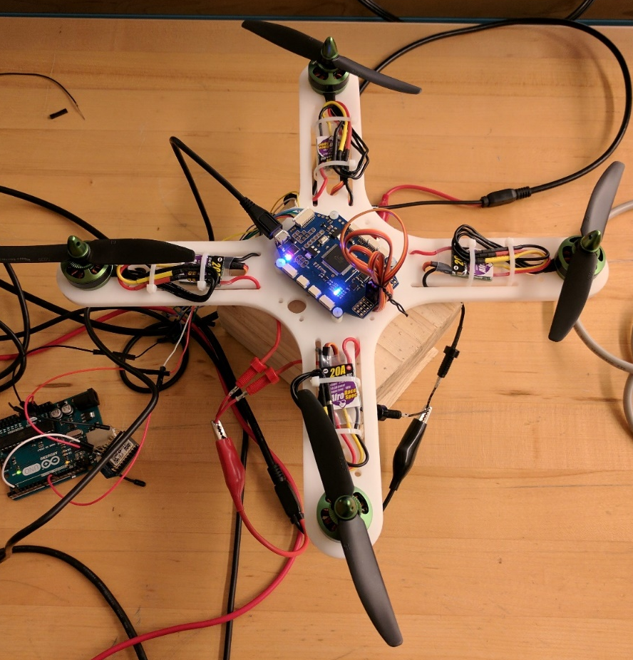
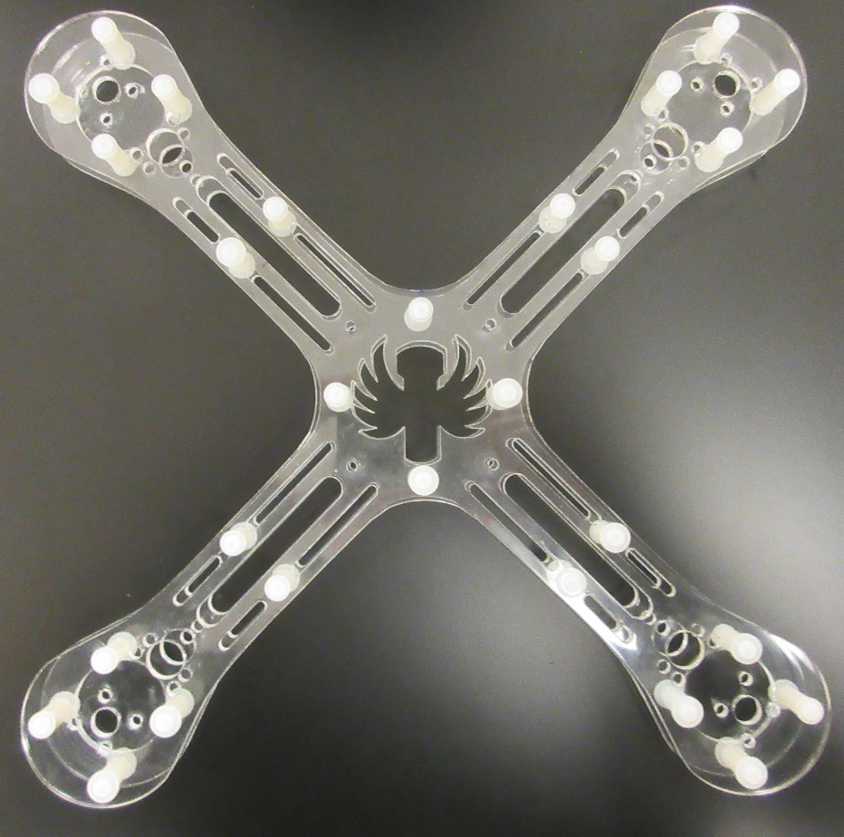
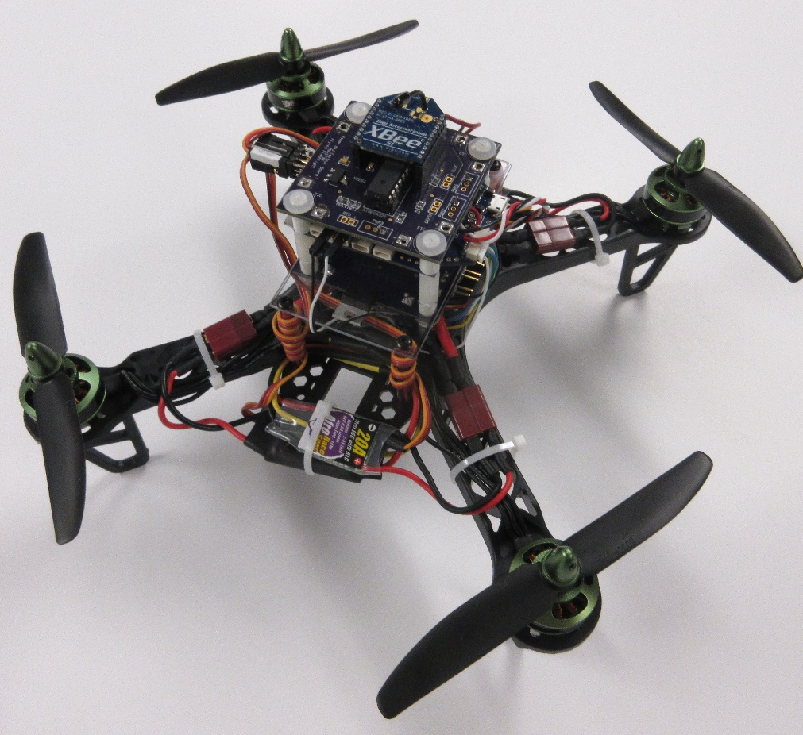
Frame Revisions

Slide 19
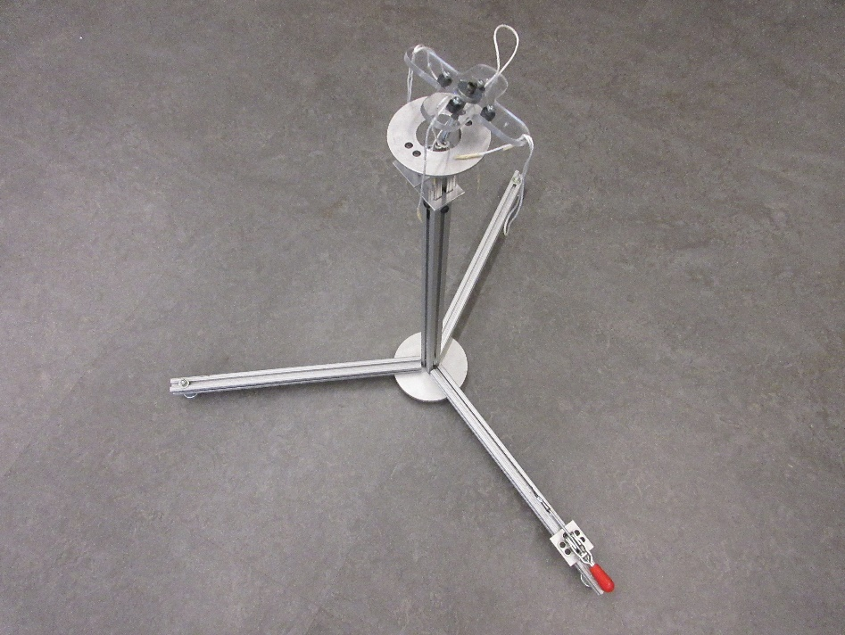
Flight Testing
Accelerometer Calibration
PID Tuning

Slide 20
Testing Results: LEDs & Communication
LED testing performed above expectations in terms of light output.
Power consumption was higher than anticipated.
Successful communication using two Arduino’s and Xbee’s to control the Quad

Slide 21
Testing Results: Flight
Autonomous flight not achieved, not enough control
User controlled flight is better but the quad still requires more tuning and oscillation dampening

Slide 22
Future Revisions
Different frame material
Different quad size
Flight controller
Control scheme

